Slide 1


Concepts of Prometheus
Misusage example of sme-features-api
Notes:
时序数据库：
influxDB
TimescaleDB

Slide 2
Prometheus
An open-source systems monitoring and alerting toolkit
Multi-dimensional data model
Flexible query language
No reliance on distributed storage; single server nodes are autonomous
Time series collection happens via a pull model over HTTP
Pushing time series is supported via an intermediary gateway
Targets are discovered via service discovery or static configuration
Multiple modes of graphing and dashboarding support

Slide 3
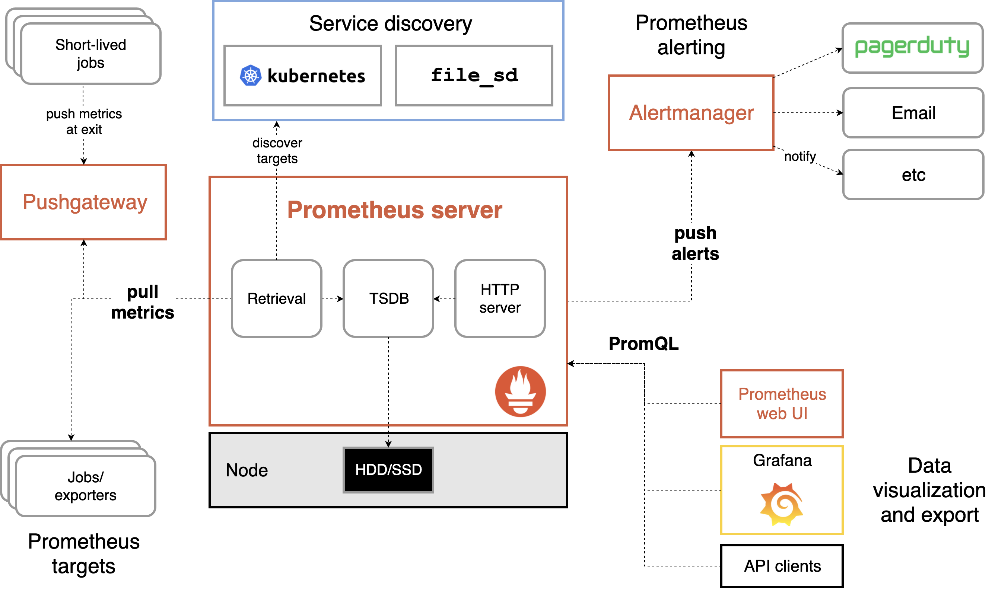
Notes:
时序数据库：
influxDB
TimescaleDB

Slide 4
When does it fit
Prometheus works well for recording any purely numeric time series.
It fits both machine-centric monitoring as well as monitoring of highly dynamic service-oriented architectures.
Prometheus is designed for reliability, to be the system you go to during an outage to allow you to quickly diagnose problems.
Each Prometheus server is standalone, not depending on network storage or other remote services.
Not fit for 100% accuracy

Slide 5
Data Model
metrics:
metrics are numeric measurements. Time series means that changes are recorded over time.
labels:
Every time series is uniquely identified by its metric name and optional key-value pairs called labels.
api_http_requests_total{method="POST", handler="/messages"}
Notes:
The metric name specifies the general feature of a system that is measured (e.g. http_requests_total - the total number of HTTP requests received).
Labels enable Prometheus's dimensional data model: any given combination of labels for the same metric name identifies a particular dimensional instantiation of that metric (for example: all HTTP requests that used the method POST to the /api/tracks handler).
<metric name>{<label name>=<label value>, ...}

Slide 6
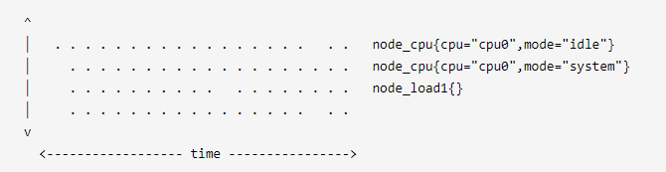
Data Model

Slide 7
Metric types
Counter:
A counter is a cumulative metric that represents a single monotonically increasing counter whose value can only increase or be reset to zero on restart. For example, you can use a counter to represent the number of requests served, tasks completed, or errors.
Gauge:
A gauge is a metric that represents a single numerical value that can arbitrarily go up and down. Gauges are typically used for measured values like temperatures or current memory usage, but also "counts" that can go up and down, like the number of concurrent requests.
Histogram:
A histogram samples observations (usually things like request durations or response sizes) and counts them in configurable buckets. It also provides a sum of all observed values.
Summary:
Similar to a histogram. While it also provides a total count of observations and a sum of all observed values, it calculates configurable quantiles over a sliding time window.
Notes:
Histogram:
[basename]_bucket
[basename]_sum
[basename]_count
Summary:
[basename]
[basename]_sum
[basename]_count

Slide 8

PromQL
instant vector ：a set of time series containing a single sample for each time series, all sharing the same timestamp
range vector ：a set of time series containing a range of data points over time for each time series
scalar ：a simple numeric floating point value
string ：a simple string value, currently unused
Notes:
瞬时向量类型是唯一可以直接在图表中使用的。

Slide 9
Time series Selectors
Instant vector selectors
Instant vector selectors allow the selection of a set of time series and a single sample value for each at a given timestamp
= , !=, promhttp_metric_handler_requests_total{code="200"}
=~, !~, promhttp_metric_handler_requests_total{code=~"200|500"}
Range Vector Selectors
Range vector literals work like instant vector literals, except that they select a range of samples back from the current instant. [5m]
promhttp_metric_handler_requests_total[5m]
s, m, h, d, w, y
Offset
The offset modifier allows changing the time offset for individual instant and range vectors in a query.
promhttp_metric_handler_requests_total[15s] offset 2d

Slide 10
Operators
Arithmetic binary operators
+
-
*
/
%
^

Slide 11
Operators
Between an instant vector and a scalar
the operator is applied to the value of every data sample in the vector.
Between two instant vectors
a binary arithmetic operator is applied to each entry in the left-hand side vector and its matching element in the right-hand vector.

Slide 12
Operators
Comparison binary operators
==
!=
>
<
>=
<=
promhttp_metric_handler_requests_total > 0
promhttp_metric_handler_requests_total > bool 0
Aggregation operators
sum
max
sum(promhttp_metric_handler_requests_total) by (job)

Slide 13
Functions
up
Increase
rate
Delta
increase(promhttp_metric_handler_requests_total[5m])
delta(prometheus_tsdb_blocks_loaded[5m])

Slide 14
Misusage examples from sme-features-api
Notes:
时序数据库：
influxDB
TimescaleDB

Slide 15
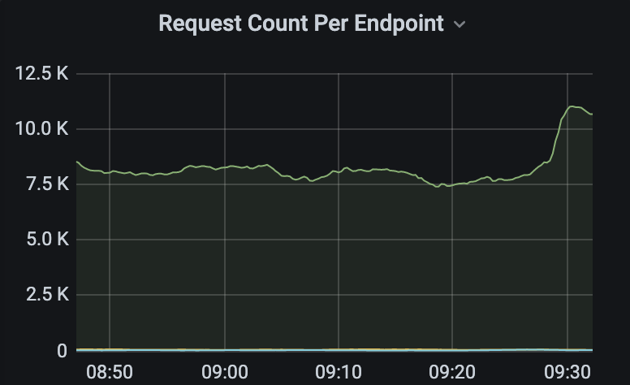
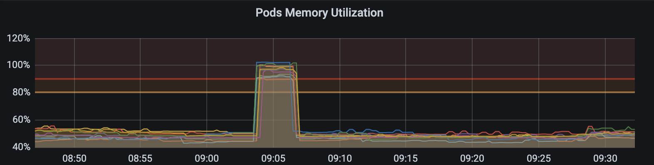

Slide 16
1 Pad contains 2 containers
feature
api
Jaeger

Slide 17
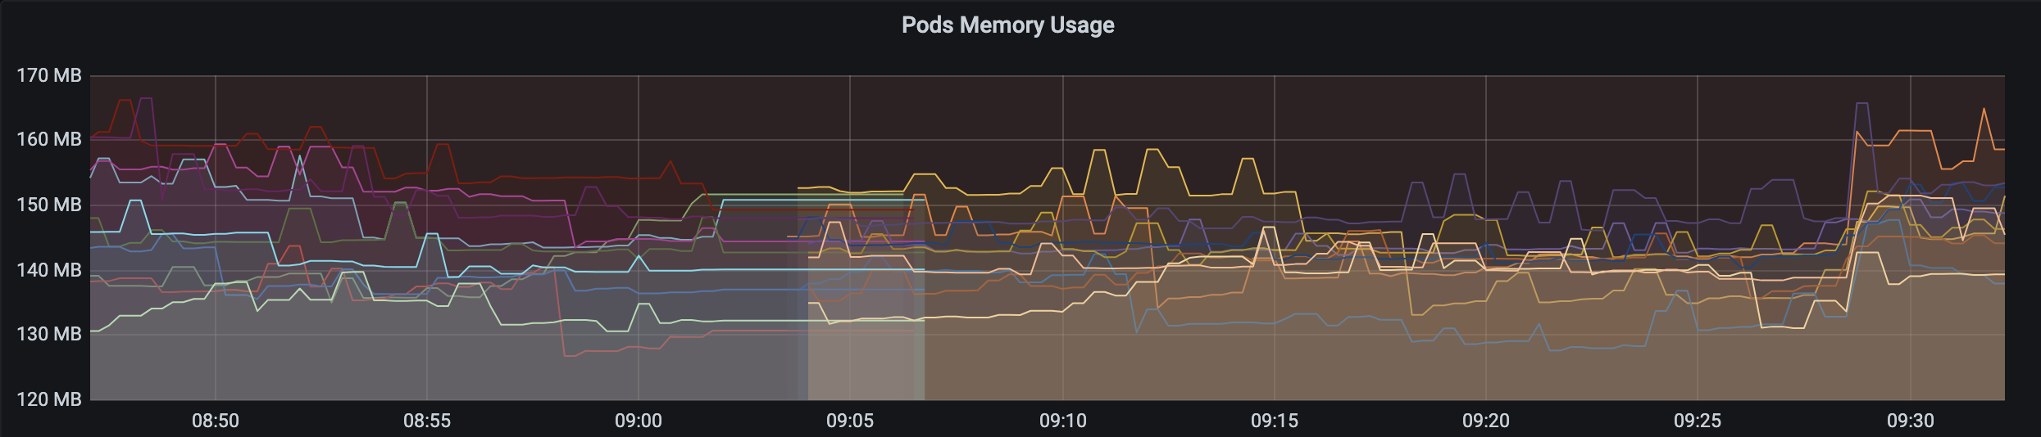
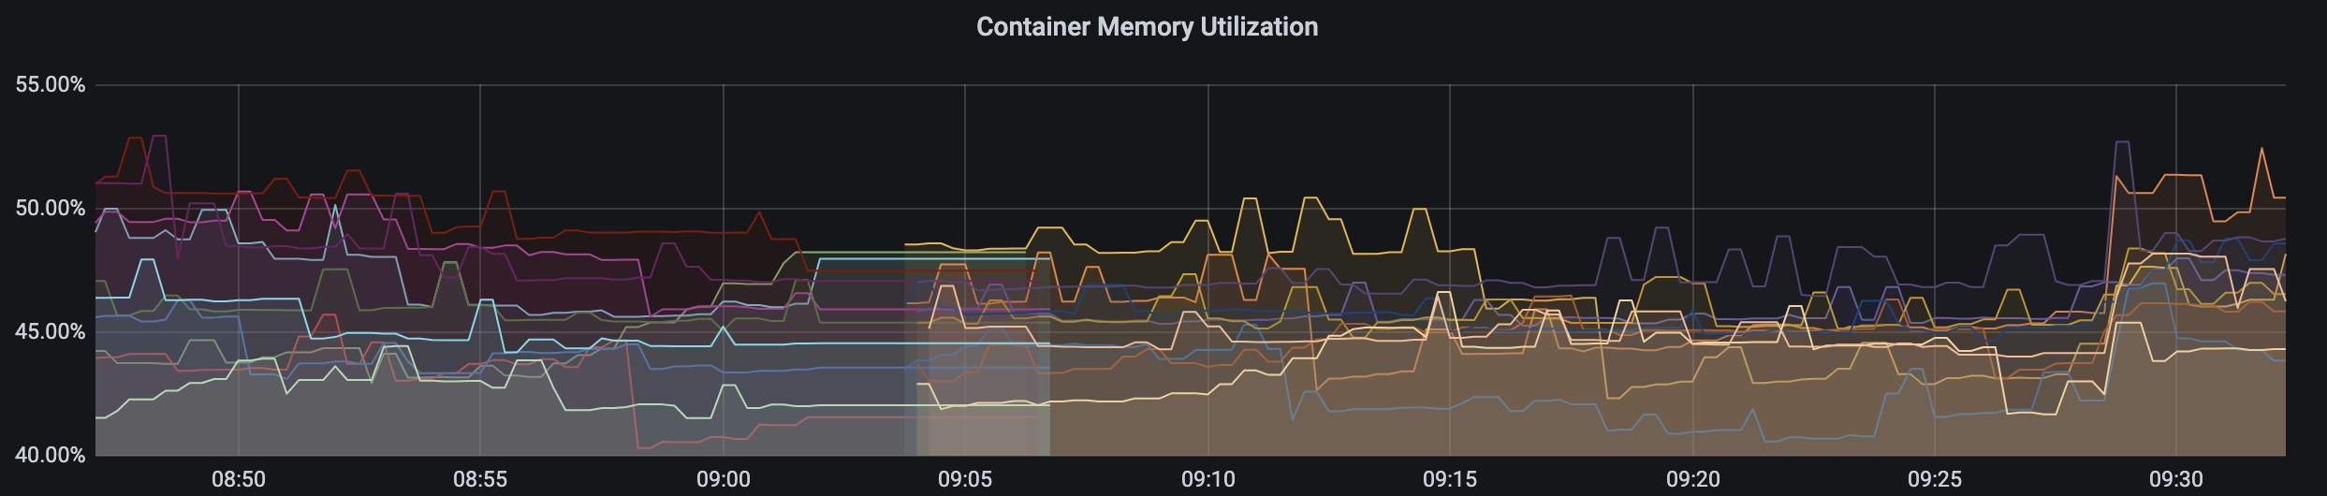
PromQL Expression
container_memory_working_set_bytes: Current working set(byte)
container_spec_memory_limit_bytes: Memory limit for the container(byte)

Slide 18
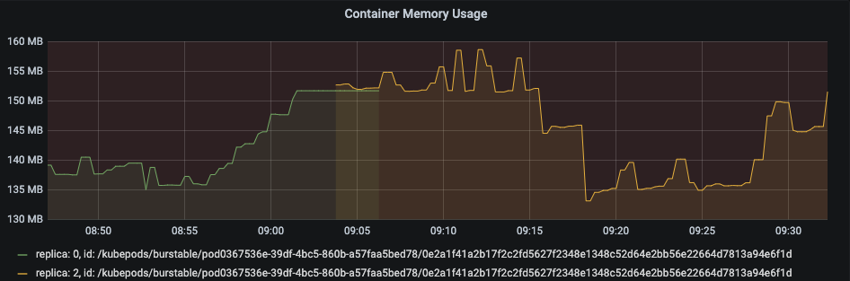
One Container Two TimeSeries
No
Pod/Container
Restart
sum(
container_memory_working_set_bytes{…} / container_spec_memory_limit_bytes{…} )
by (pod_name) * 100

Slide 19
Incorrect Expression
C1
C2
Pod Usage: 80 + 90 = 170MB
Pod Limit: 100 + 200 = 300MB
Pod Utilization: 56%
Memory Usage: 80MB
Memory Limit: 100MB
Memory Utilization: 80%
Memory Usage: 90MB
Memory Limit: 200MB
Memory Utilization: 45%
sum(
container_memory_working_set_bytes{…} / container_spec_memory_limit_bytes{…} )
by (pod_name) * 100
Pod Utilization:
80% + 45% = 125%

Slide 20
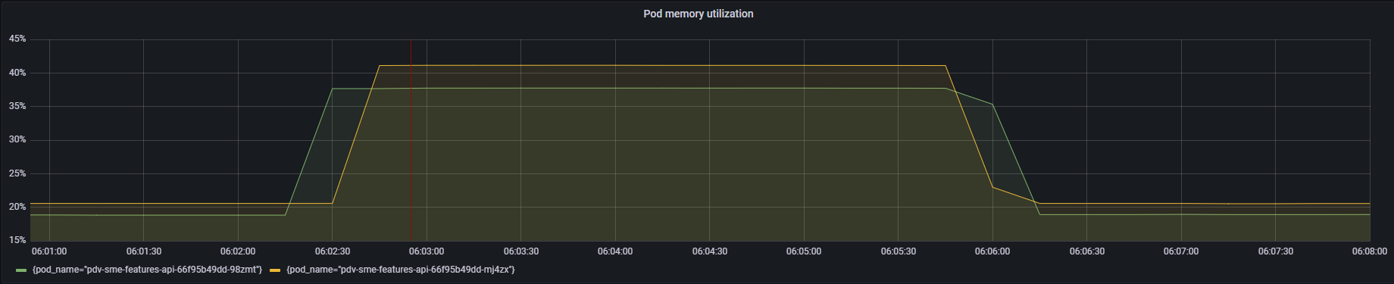
20%
20% + 20%
20%

Slide 21
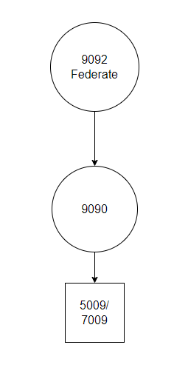

Slide 22
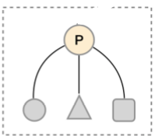
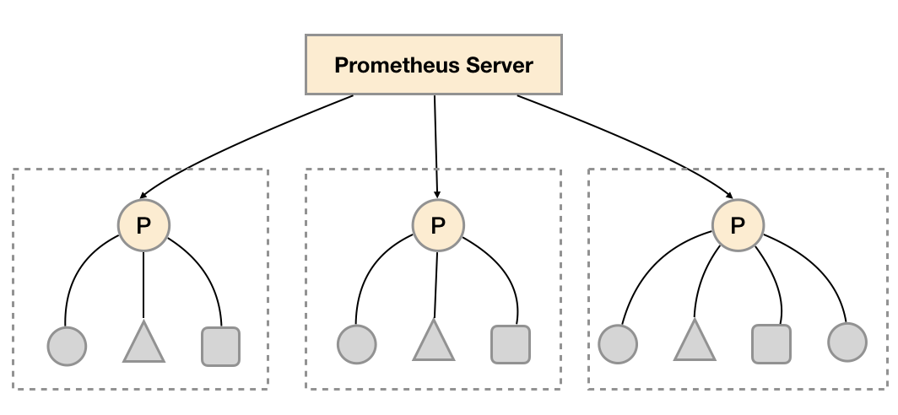
Federation & Staleness
Staleness will not be marked for time series that have timestamps included in their scrapes. Only the 5 minute threshold will be applied in that case.

Slide 23
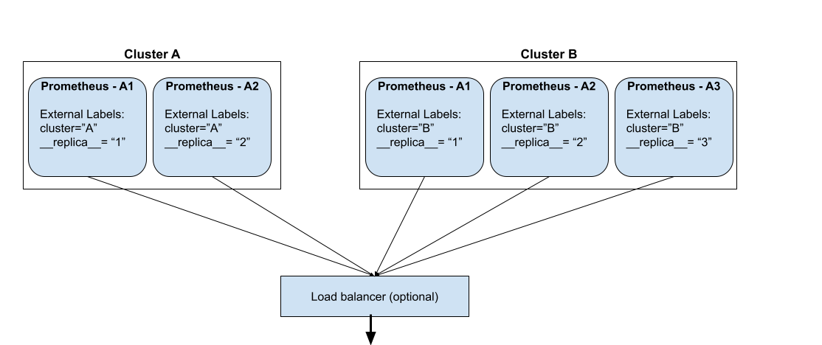
High availability
HA pairs
De-duplicating
It does this by electing a leader Prometheus instance and only ingesting data from that leader

Slide 24
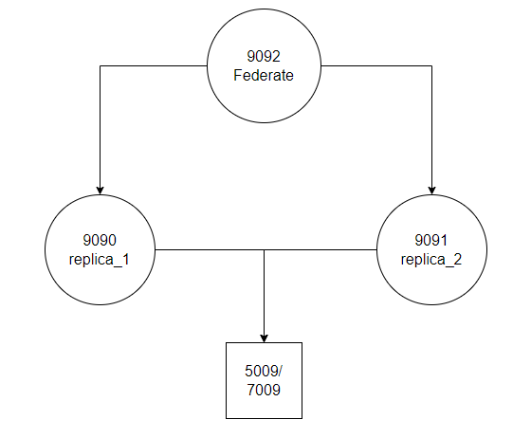

Slide 25
Solutions
sum(
container_memory_working_set_bytes{…} / container_spec_memory_limit_bytes{…} )
by (pod_name) * 100
sum-Container
max(
container_memory_working_set_bytes{…} / container_spec_memory_limit_bytes{…} )
by (pod_name) * 100
Show the max memory utilization of the container
max-Container
sum(container_memory_working_set_bytes{…} by (pod_name)) / sum(container_spec_memory_limit_bytes{…} by (pod_name))
* 100
Show the accurate memory utilization of the POD
avg-Pod

Slide 26
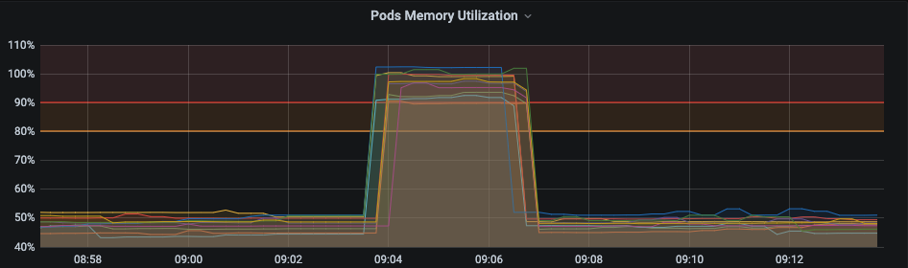
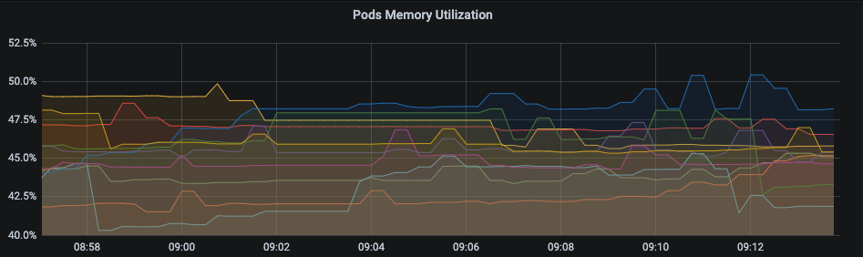
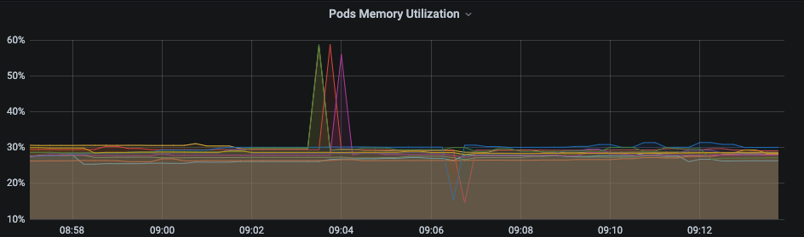
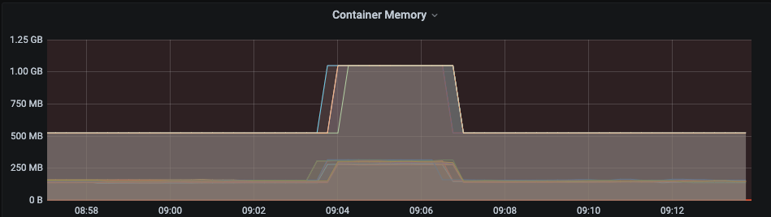
Results
sum-Container
max-Container
avg-Pod

Slide 27
Thanks!
Notes:
时序数据库：
influxDB
TimescaleDB

